Slide 1
Measuring ROI in an Agentic World
Risk Management & Autonomous Governance
Choosing Vendors & Architecture

Slide 2
Measuring ROI in an Agentic World

Slide 3
Traditional AI ROI looks at time saved per task.
Agentic AI ROI must be measured like hiring a human employee.

Slide 4
Traditional AI ROI (Time Saved per Task)
Example: You deploy an ML model that takes input invoices and suggests General Ledger accounts (GL code 6200 or 4500).
Invoice | ML_Predict_GL_code | Confidence | Approve by clerk ?
inv1 | GL 6200 | 94% | ✅
Inv2 | GL 4500 | 10% | ❌
Inv3 | GL 4500 | 98% | ✅
….
Invoice
ML Model
GL XXXX
Step1: The ML model looks at the invoice — vendor name, line-item description, amount, historical patterns — and predicts the correct GL code, e.g.:
"Acme Cloud Services → GL 6200 (Software Subscriptions) — 94% confidence“
Step2: Then clerk reviews and confirms (or overrides).
Instead of picking from hundreds of accounts manually, they just approve a suggestion.

Slide 5
The logic: AI accelerates a task a human still owns.
ROI = (time saved × volume × rate) − cost
Metric | Value
Time saved per invoice | 2 minutes
Invoices/month | 10,000
Hours saved/month | ~333 hrs
Loaded labor rate | $35/hr
Monthly savings | ~$11,650
Annual savings | ~$140,000
Implementation cost | $150,000
Payback | ~13 months
The limitation: The human is still in the loop. You saved keystrokes, not headcount
( The clerk still touches every invoice and sends it to the GL account)

Slide 6

Agentic AI ROI (Hiring an Employee / Outsourcing a Process)
Now you deploy an agent that owns end-end workflow:
1. ingests invoices,
2. matches Pos and resolves mismatches by emailing vendors,
3. codes exceptions,
4. routes for approval, and
5. posts to the ERP.
Metric | Value
Fully-loaded cost of 3 AP clerks | $210,000/yr
Agent platform + inference + integration | $60,000/yr
Human exception reviewer (=0.5 FTE, half of full-time employee) | $35,000/yr
Net annual savings | $115,000
Cost per invoice processed | drops from ~$1.75 → ~$0.79
Capacity added | 3× volume with no new hires
A human only reviews flagged exceptions.
You're replacing a role.

Slide 7
The logic mirrors a hiring decision:
Cost to "employ" the agent (licensing + inference + oversight)
Throughput it delivers (invoices/day, no ramp time, 24/7)
Quality/error rate vs. the human baseline
Scalability — can it handle 3× volume without 3× cost?
Retention risk — none (vs. turnover, training, hiring lag)
Payback period — often measured in months, not years
Question:
Would you rather
hire 3 more clerks at $210K/yr,
outsource to a BPO at $150K/yr, or
"hire" an agent at $95K/yr that never sleeps and scales instantly?

Slide 8
From Efficiency to Outcomes:
Shift focus from “How fast did the AI write an email?” to “Did the AI autonomous agent successfully resolve the customer billing dispute from end to end?”
“Did the AI autonomous agent resolve the customer billing dispute from end to end?”
“How fast did the AI write an email?”

Slide 9
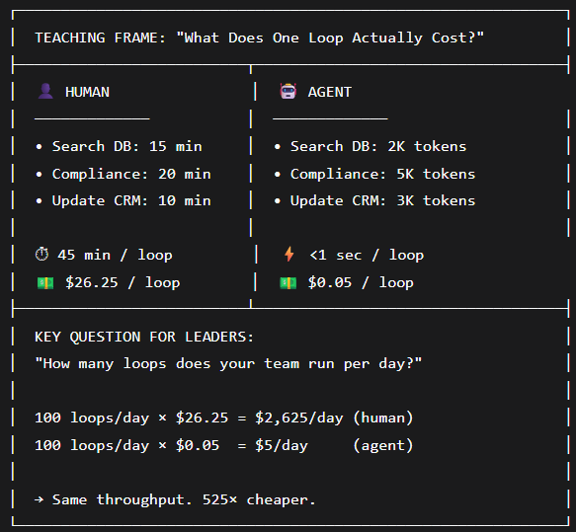
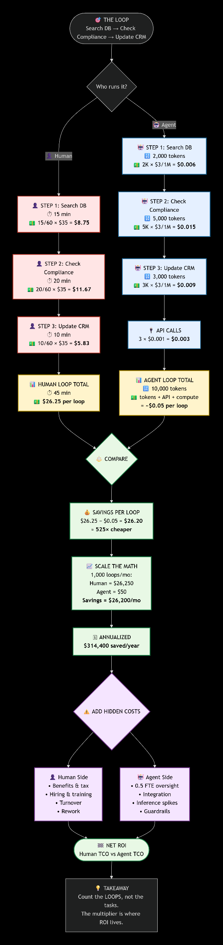
The "Cost-per-Task" Metric: Leaders calculate the token and computational costs of an agent executing a loop (e.g., searching databases, checking compliance, updating CRM) versus the hourly wage of a human doing the same manual process.
Or use this one

Slide 10
2. Risk Management & Autonomous Governance

Slide 11
When you give AI the agency to act, click buttons, and spend money, the risk profile changes drastically.
Leaders must build an Agent Governance Framework.
3 key concepts
Human-in-the-Loop
Understanding Cascading Agent Failures
Liability and Accountability

Slide 12
The "Human-in-the-Loop" Threshold: Define explicit financial or operational guardrails.
  Example: An agent can autonomously issue client refunds up to ₹5,000, but requires a human manager's digital signature for anything higher.
Refund
Agent
Amount > 5,000
Need human manager's digital signature
Automatically approve the refund
Amount < 5,000

Slide 13



Cascading Agent Failures:
The risk of "agent loops," where two autonomous systems get stuck in a feedback loop (e.g., an automated purchasing agent arguing with an automated pricing agent), draining computing budgets in minutes.
Needs better price
Purchasing
Agent
Pricing
Agent
The price offered is discounted

Slide 14
Liability and Accountability:
Establish who owns the mistake when an agent makes an unauthorized commitment—is it the
software vendor,
internal prompt engineer, or
department head?

Slide 15
3. Choosing Vendors & Architecture

Slide 16
Leaders must be able to cut through marketing hype to evaluate the technical foundations of enterprise agent platforms.
Proprietary Ecosystems vs. Open Frameworks:
Compare the pros and cons of ecosystem-locked solutions (like Microsoft Copilot Studio or Salesforce Agentforce) against open-source orchestration frameworks (like LangChain or AutoGen).
Aspect | Proprietary Ecosystems | Open Frameworks
Best For | deep integration with a specific vendor stack | Complex, custom logic, multi-model flexibility, and avoiding vendor lock-in
Speed to Market | Fast (days to weeks) | Slower (weeks to months)
Customization | Low to Moderate | Maximum
Lock-in Risk | High | Low
Operational Burden | Low (vendor-managed) | High (self-managed)
Ideal User | Business teams, citizen developers | AI engineers, hardcore developers

Slide 17
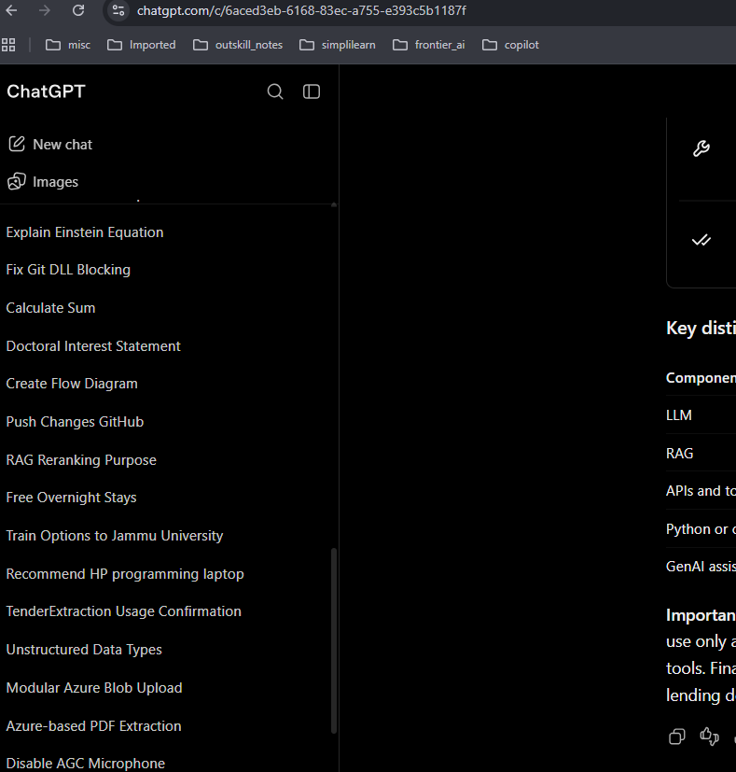


Memory and Integration Capabilities:
A true enterprise agent needs
robust semantic memory (remembering past user interactions) and
easy API integrations into legacy systems (ERP, HR systems, core databases).

Slide 18
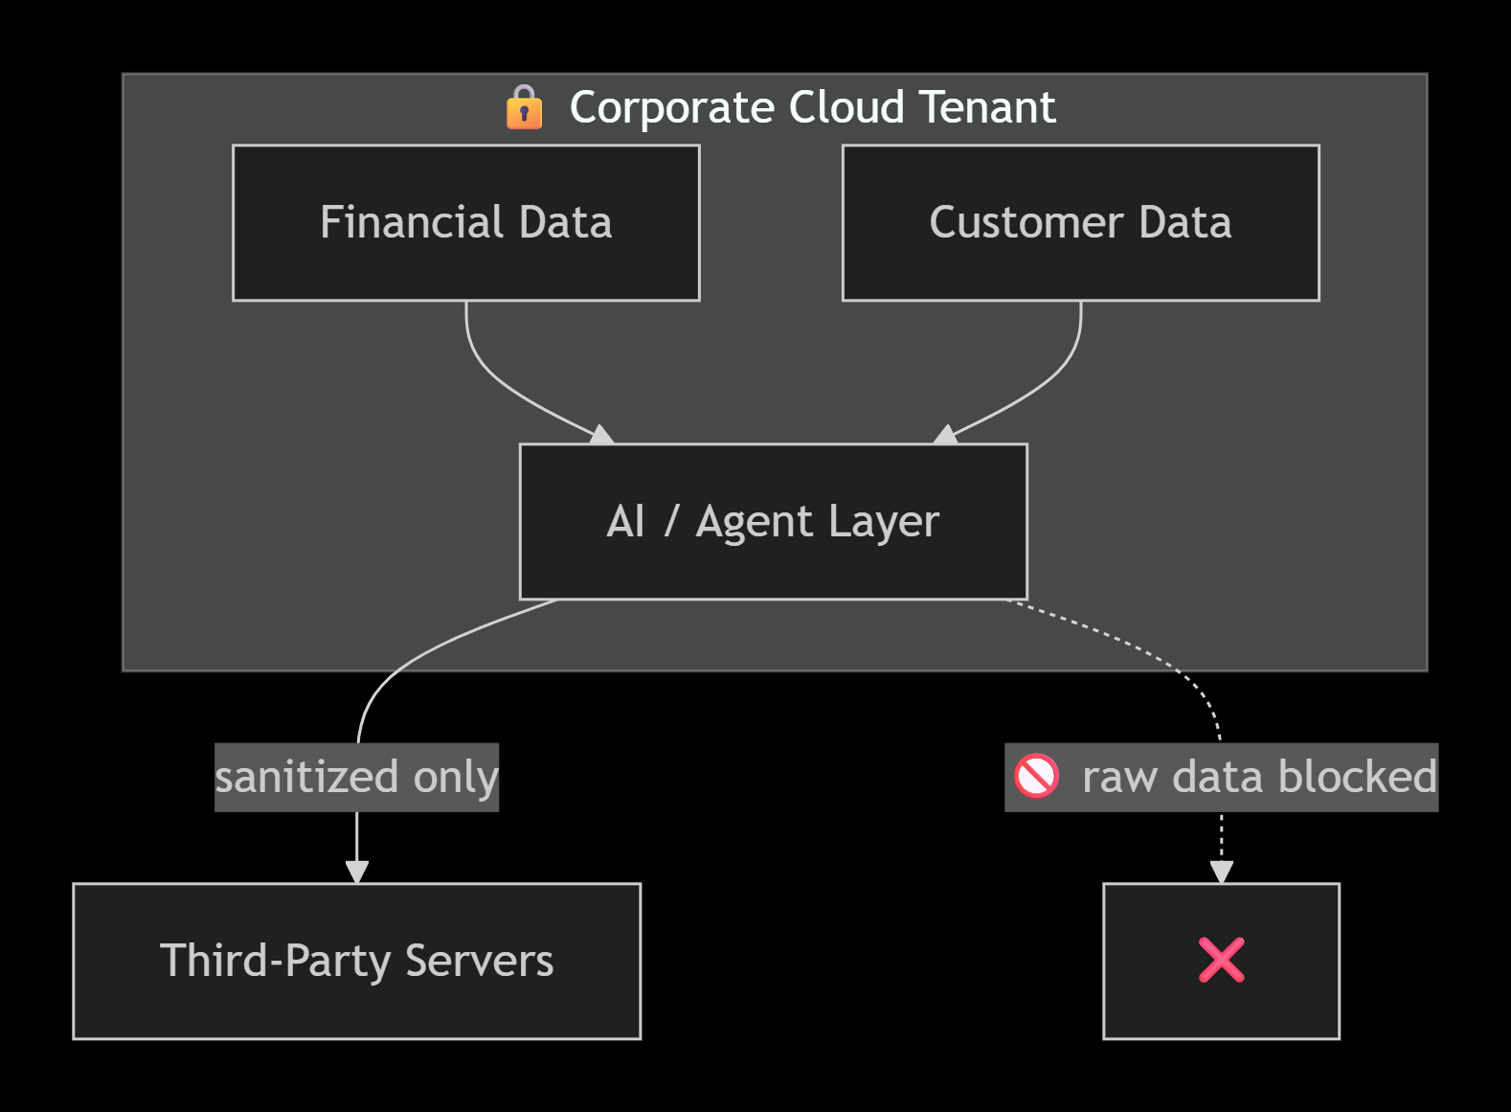
Data Sovereignty and Security:
Ensure vendors comply with strict localized data laws.
Financial and customer data must remain sandboxed within the corporate cloud tenant rather than passing through third-party servers.
No PII,
No Salary of Employees

